Slide 1

Automated Outsourcing Services
Introduction to our business

Slide 2
Agenda
  Credentials
  Jurisdiction
  Clients
  Group Structure
  Core Competencies
  Licenses
  Systems
  Web Applications
  Other

Slide 3
Credentials
Automated Outsourcing Services [AOS] is an independent 3rd party fund administration, financial services and technology company with operations in South Africa and Guernsey. The company has the capabilities and licensing to hold and administer local and offshore collective investment schemes, exchange traded products, and local and offshore structured products as well as other retirement and investment products. AOS provides customised fund administration, business, and technology solutions to the financial services sector via various outsource models, specialised technology, methodologies, and highly skilled employees.
  Established in 1997
  ISO/IEC 27001:2022 – Information Security Management
  ISO 9001:2015 – Quality Management
  Assets Under Administration – R75 billion
  30 Institutional Clients
  Administer over 350 Retail & Institutional Funds/Products
  Administer over 500,000 Client Records

Slide 4
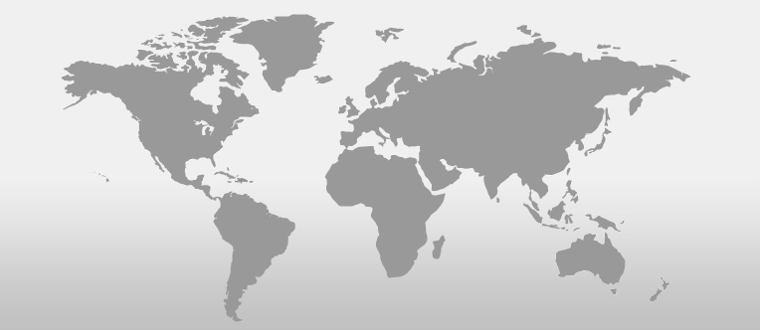
Business Jurisdictions
GIMCL
Guernsey
AOS
South Africa

Slide 5

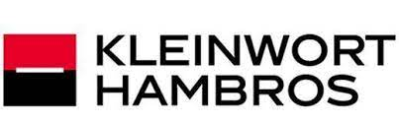
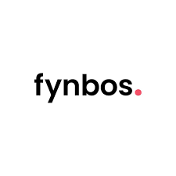


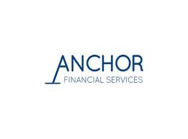
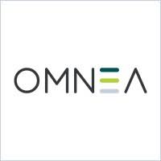
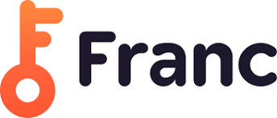


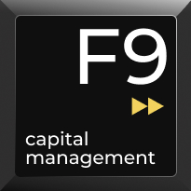









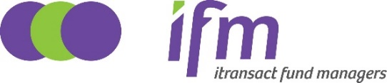

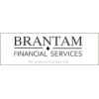




Clients

Slide 6
Group Structure
AOS Current
Executive Directors
Prime Financial
Services (Pty) Ltd
Automated Outsourcing Services
(Pty) Ltd
Itransact
Investment
Product
Platform
www.itransact.co.za
Guernsey
International
Management
Company
Limited
Investors
Independent
Nominee
(Pty) Ltd
Itransact
Fund Managers
(RF) (Pty) Ltd
Index Solutions
www.indexsolutions.co.za

Slide 7
Core Competencies
  ETFs – Branded Investment Plan Product Platforms
  Securities Trading (Execution)
  CIS, Hedge and Private Equity Funds
  Mutual Funds including PCCs
  Wrap Funds & Life Portfolios
  Segregated Portfolio Admin
  Retail Pension Benefit Admin
  Investment Product Platform – ETF’s, ETN’s, ETF Portfolios, Retirement Annuity, Preservation Fund, Living Annuity, Unit Trusts
  Structured Products, Protected Funds , AMC, Endowment Policy
  White Labelling – PCCs, CISs, Robo Advisor, Platform Products
  Customer Interaction Centre and Reporting Platform
  Registry & Nominee Services
  Low Cost Products / Payroll Deductions
  Asset Management – Index (Passive) Solutions, Segregated Retail and Institutional Portfolios

Slide 8
Licenses
AOS:
FAIS Category I FSP – Intermediary Services
FAIS Category III FSP – Administrative FSP
Collective Investment Schemes
Section 13B – Investment & Benefit Administrator
100% owned subsidiaries:
Nominee Company (FSCA and Strate approved)
Offshore CIS Management Company
Offshore Protected Cell Company
Partially owned subsidiaries:
Local CIS Management Company
FAIS Category II FSP – Discretionary FSP

Slide 9
Systems
PAXUS (ASSET)
PFS-PAXUS is an internationally developed specialist fund accounting and fund administration system used globally by fund administrators. It is a complete back-office fund accounting, portfolio valuation, fund pricing solution and shareholder recording keeping administrative solution on a single, fully integrated system. Multi-series unit pricing, partnership allocation, administration fee calculation, management fee calculation, incentive fees, high watermarks, hurdle rates and equalisation are all supported.
FINWORKS (LIABILITY)
The Finworks system is a fully hosted solution offered on a SaaS (software as a service) model where Finworks take care of all the supporting technology around the system, including hardware, security, hosting and other infrastructure requirements. The system is maintained and upgraded on an ongoing basis. Finworks can handle traditional CIS administration and has all the required product layers built in.
INDEX SOLUTIONS ASSET & PORTFOLIO MANAGEMENT SYSTEM
In house developed passive asset & portfolio management system consisting of Mean Variance Optimisation and Data Analysis & Visualisation services. Fully integrated rebalancing and reporting suite.

Slide 10
Web Applications
iReport - Online reporting and transacting
  Can be integrated with any underlying system. Currently integrated with Finworks and Paxus allowing investors to access their information at any time
NIBS – Digital encrypted interactive statement
  Apart from delivering statements to investors, it also allows any other form of communication with investors

Slide 11
Other
Protected Cell Company Administration
  AOS’s 100% owned Guernsey domiciled subsidiary, Guernsey International Management Company Limited, is manager to The Offshore Mutual Fund PCC Limited, which offers Guernsey offshore funds
  In addition to performing the administration of our own above PCC, AOS also performs the administration of a further 2 Guernsey and 2 Abu Dhabi domiciled PCC’s

Slide 12
End
Questions?
Please contact us on
  + 27 (0)11 561 6600
  info@aospartner.com

